Slide 1


SAP UI5 FIORI
Data Object Model
© Copyright 2021, ZaranTech LLC. All rights reserved.

Slide 2

Disclaimer
2
This presentation, including examples, images, and references are provided for informational purposes only.
Complying with all applicable copyrights laws is the responsibility of the user.
Without limiting the rights under copyright, no part of this document may be reproduced, stored or introduced into a retrieval system, or transmitted in any form or by any means.
Credits shall be given to the images taken from the open-source and cannot be used for promotional activities.
© Copyright 2021, ZaranTech LLC. All rights reserved.

Slide 3
Agenda
3
Data Object Model
Relating HTML Elements
© Copyright 2021, ZaranTech LLC. All rights reserved.

Slide 4
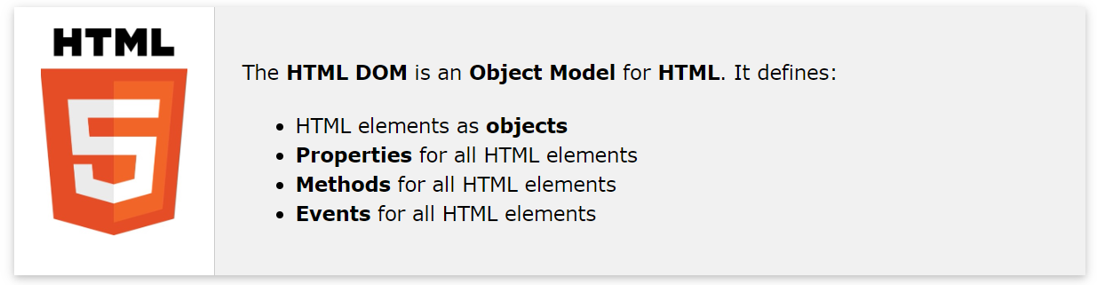
Data Object Model (DOM)
2
‹#›
© Copyright 2021, ZaranTech LLC. All rights reserved.

Slide 5
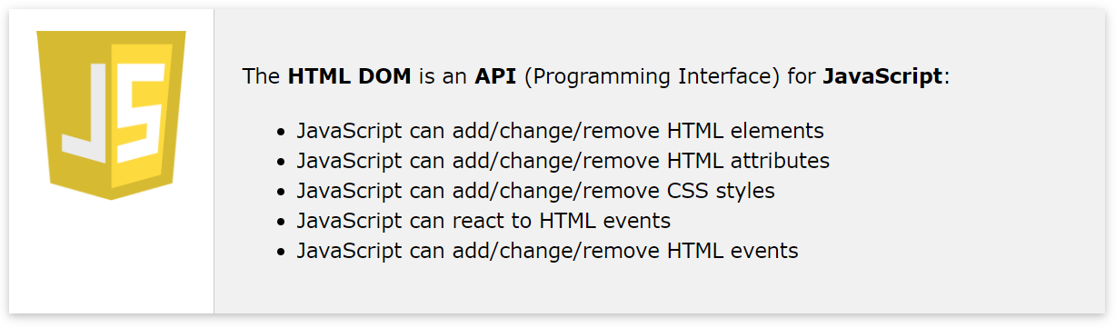
Data Object Model (DOM)
2
‹#›
© Copyright 2021, ZaranTech LLC. All rights reserved.

Slide 6
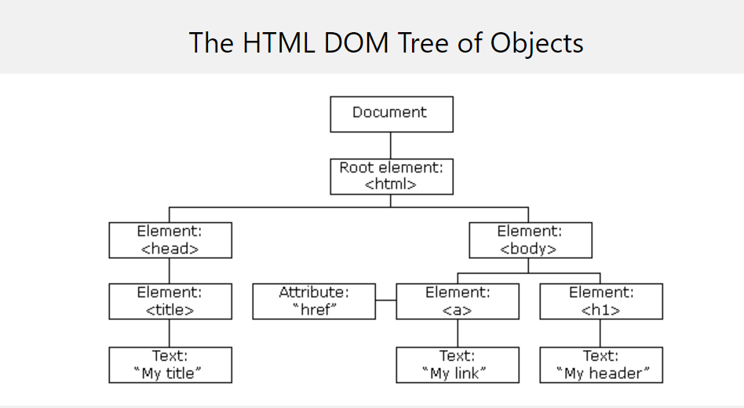
Data Object Model (DOM)
2
The HTML DOM
When a web page is loaded, the browser creates a Document Object Model of the page.
‹#›
© Copyright 2021, ZaranTech LLC. All rights reserved.

Slide 7
Relating HTML Elements
2
Finding HTML Elements
When you want to access HTML elements with JavaScript, you have to find the elements first.
Ways of Finding HTML Elements
Finding HTML elements by id
Finding HTML elements by tag name
Finding HTML elements by class name
Finding HTML elements by CSS selectors
Finding HTML elements by HTML object collections
‹#›
© Copyright 2021, ZaranTech LLC. All rights reserved.

Slide 8
Relating HTML Elements
2
Finding HTML Elements by HTML Object Collections
HTML Object Collections are also accessible by:
HTML Object Collections
document.anchors
document.forms
document.images
document.links
document.scripts
‹#›
© Copyright 2021, ZaranTech LLC. All rights reserved.

Slide 9
Thank you
Subscribe to our Channel for more Informative Videos.
https://www.youtube.com/user/ZaranTech

